Slide 1


SCADA for Sailing Boat Autopilot
Natalia Drzazga, Jan Gorgoń

Slide 2
SCADA for Sailing Boat Autopilot
Maintaining the course of sailing using rudder
Alarm defined for the situation of too low/high level of battery voltage
Triggering the state of engine needs authorization
Visualisation and animation of courses
Autopilot needs to be turned on to maintain course
Software should maintain selected course without overshooting

Slide 3
Environment
AVEVA InTouch HMI
Wide range of graphical elements for HMI visualization
Possibility to create own elements
Scripts for backend
Alarm managing
Access levels

Slide 4
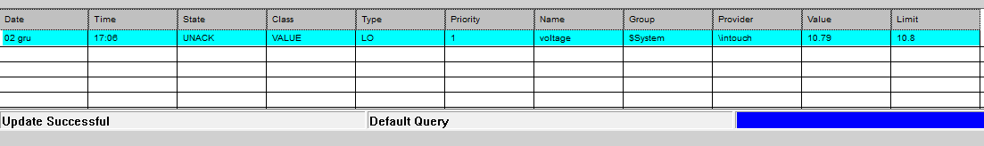
Alarm for battery voltage
Alarm occurs when voltage is:
Lower than 10.8 V
Higher than 14.4 V
Dissmissed by turning on/off the engine

Slide 5
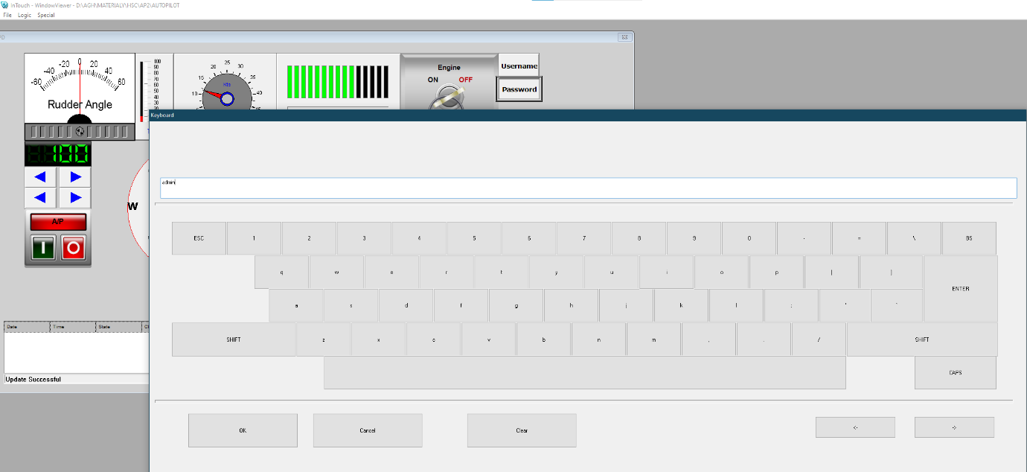
Login Panel
User need to log in providing right username and password

Slide 6
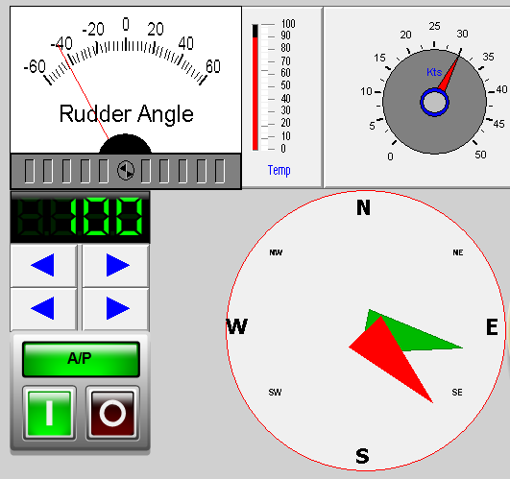
Autopilot panel
Buttons changing the set course
Switch turning on the Autopilot
Rudder angle gauge shows the current inclination of rudder
Thermometer and speedometer
Compass

Slide 7

Historic course panel
Shows the history of boat turning
in last few seconds

Slide 8
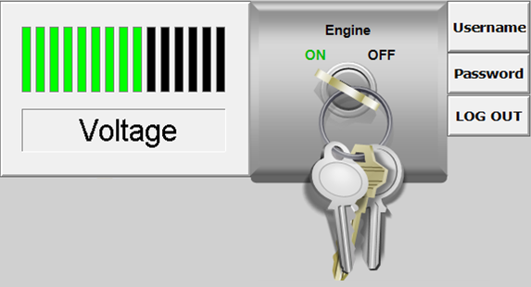
Ignition starter and battery voltage

Slide 9
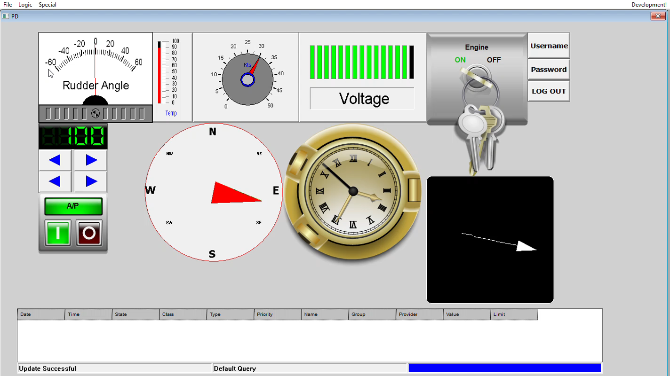

Slide 10
Thank You! Questions?

